Slide 1


Sentiment Analysis on Movie Reviews
Ben Salzman - Gregy Thomas - Jude Alfuraih
Mingyu Liao - Shreerang Javadekar - Vandik Zaveri

Slide 2
Outline
Problem Statement
Data Set & Understanding
Analysis
Results & Recommendations

Slide 3
Problem Statement
Marvel Pictures wants to know what genre/type of movie to produce for 2020
Identifying sentiments associated with positively and negatively rated movies.
Using sentiments expressed across reviews to build marketing campaigns for upcoming movies.

Slide 4

Data Set and Understanding
50,000 IMDB labeled and unlabeled movie reviews
ID, Review, & Sentiment
Notes:
Talk about the data, for example that we had labeled training data and unlabeled test data.

Slide 5
Approach
Lemmatization and Stop-Word Removal
Additional Stop Words considered that do not provide much information about the sentiment of the review.
Identifying Best Vectorizer based on review similarity
PCA and t-SNE: Identifying dimensions of highest variability
Clustering

Slide 6
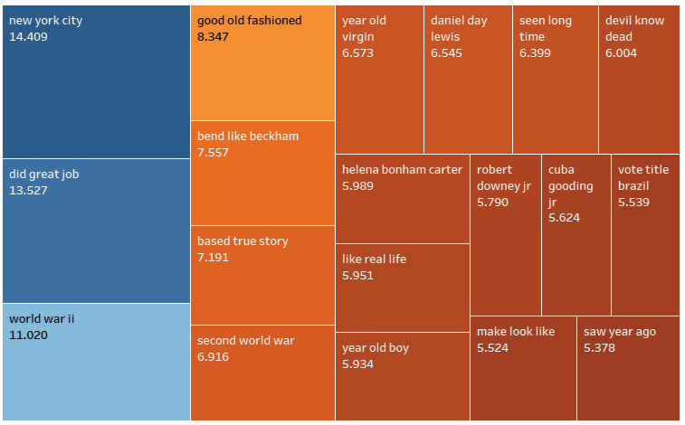
Positive Review

Slide 7
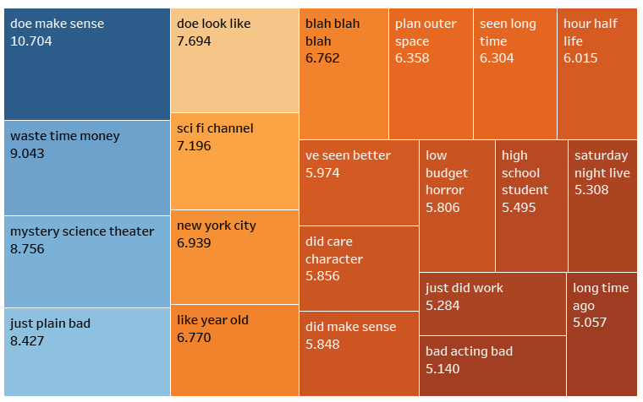
Negative Review

Slide 8
Analysis
Meaningful Phrases
Ran analysis to uncover common themes for positive and negative reviews
Sentiment Prediction
Employed deep learning model to predict aspects for positive and negative reviews
Learnings will help drive marketing focus for future movies
Notes:
Meaningful Phrases - We used Count Vectorizer, TF-IDF, and Word Embeddings for our analysis. After assessing each method, we felt Word Embeddings provided the best results
Sentiment Prediction - We employed a deep learning neural net model that has over 86% accuracy

Slide 9
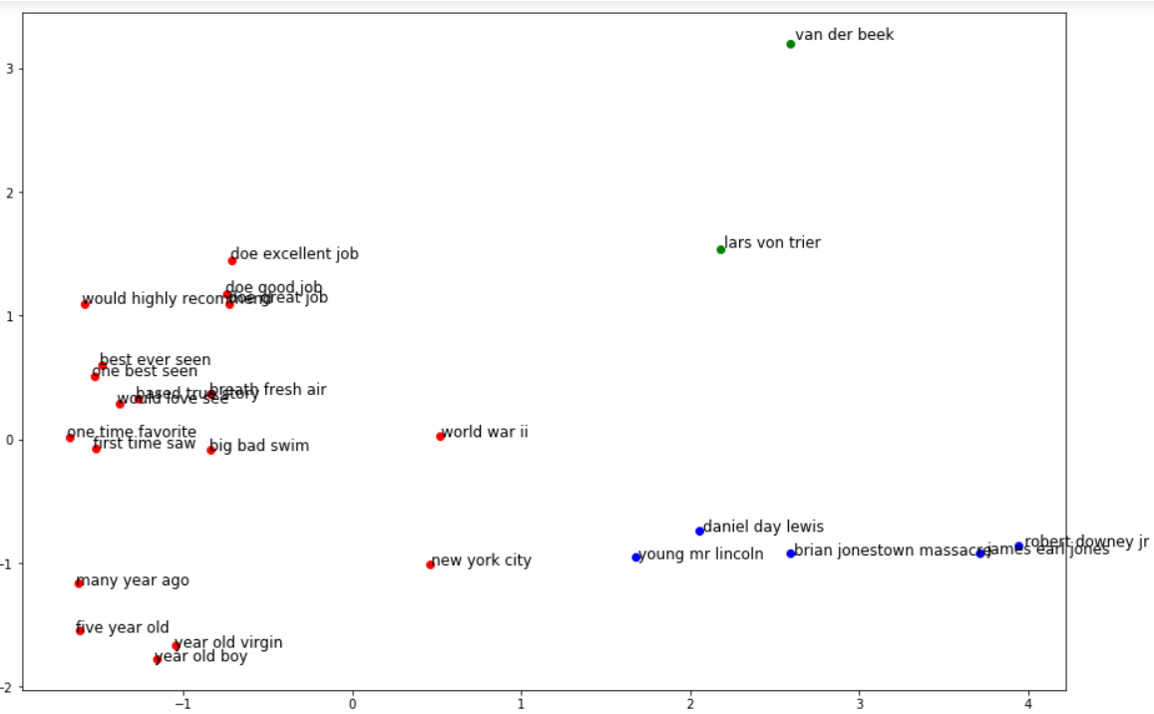
Clustering Results - Positive Reviews
Popular Actors
Based on true stories, especially war (WWII and Civil War)

Slide 10
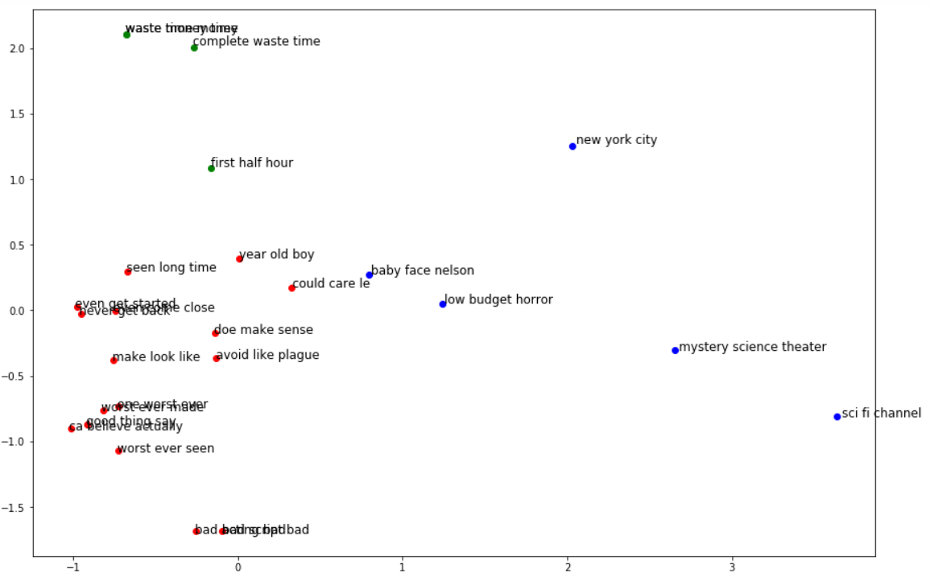
Clustering Results - Negative Reviews
Sci-fi
Scary
Low Budget

Slide 11
Sentiment Model
Predicting sentiment expressed in comments to understand how a campaign is perceived - drive future campaigns
Model Details: Deep Learning Neural Nets
Accuracy: 86%

Slide 12
Questions

